Slide 1
IronKaggle
January 2022 COHORT
One Day Challenge

Slide 2
What is an IronKaggle?
An IronKaggle is a one day challenge event where you will use your analytical and technical skills to tackle a given problem.

Slide 3
WHY ARE WE DOING THIS??

Slide 4
GOALS
Datathon = Mini ML project.
Challenge yourself.
Great learning opportunity.
Learn from team mates.
Have a great time!

Slide 5
CHALLENGE

Slide 6
Ironhack Market wants to expand the business
They want to know the revenue of each store each day in order to decide their future steps as a company.
They hire you as a Data Analyst

Slide 7
The objective is to analyse or predict the revenue of the shops in each day.

Slide 8
TRACK 1:
THE PLAN
10.30 h sales.csv
~ 640000 rows - label included
16.00 h validation_for_students.csv
~ 71200 rows - label excluded
16.30 h Predictions delivery
17.00 h Winner announcement

Slide 9
THE PLAN
10.30 h sales.csv
~ 640.000 rows - label included
15.30 h validation_for_students.csv
~ 71.200 rows - label excluded
16.30 h Predictions delivery
17.00 h Winner announcement

Slide 10
THE PLAN
10.30 h sales.csv
~ 640.000 rows - label included
15.30 h validation_for_students.csv
~ 71.200 rows - label excluded
16.30 h Predictions delivery
17.00 h Winner announcement

Slide 11
THE PLAN
10.30 h sales.csv
~ 640.000 rows - label included
15.30 h validation_for_students.csv
~ 71.200 rows - label excluded
16.30 h Predictions delivery
17.00 h Winner announcement

Slide 12
EVALUATION ON THE VALIDATION SET
You must send you predictions directly to Erin via Slack.
The models will be evaluated using RMSE.
You can submit up to 3 prediction arrays. We will keep your best score (indicated which is your favourite one in the name)

Slide 13
EVALUATION ON THE VALIDATION SET
You must send you predictions directly to Erin via Slack.
The models will be evaluated using RMSE.
You can submit up to 3 prediction arrays. We will keep your best score (indicated which is your favourite one in the name)
index | Sales
... | ...
... | ...

Slide 14
LAST TIPS & TRICKS!
Deliver on time!
Learn from each other.
Splitting the work is OK.
You’re stronger together.
WORK FAST, HAVE FUN!

Slide 16
TEAMS:

Slide 17
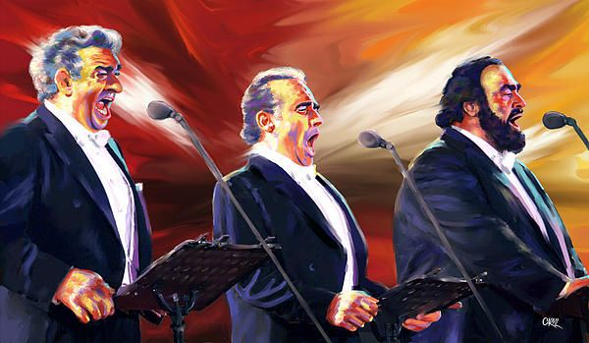
The Three Tenors
Daniel
Samet
Eric

Slide 18
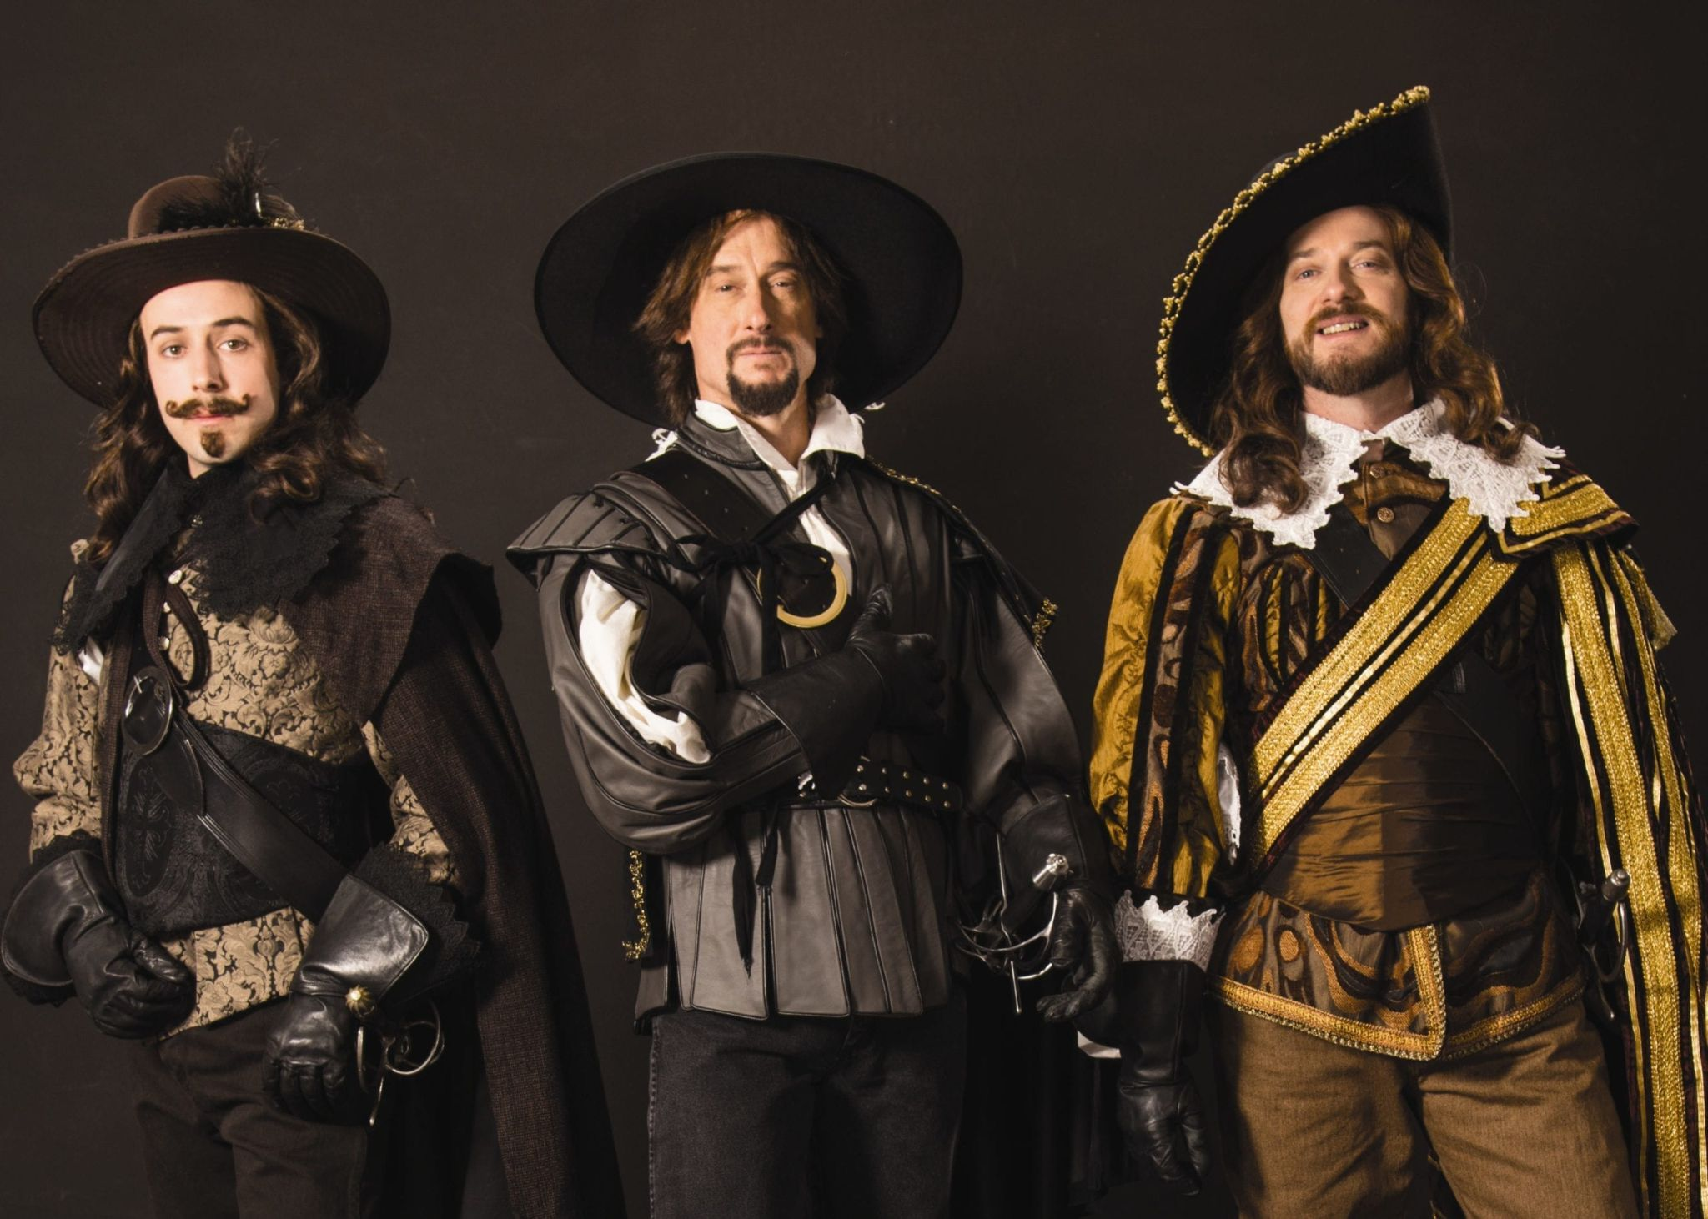
The Three Musketeers
Marcel
Lex
Eleni

Slide 19
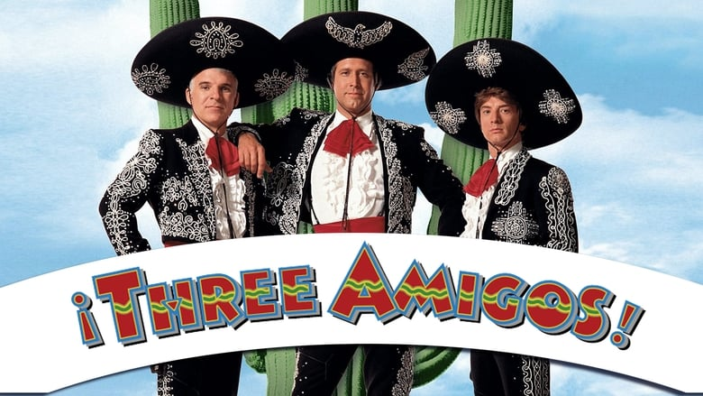
The 3 Amigos
Victor
Manuel
Lidia

Slide 20
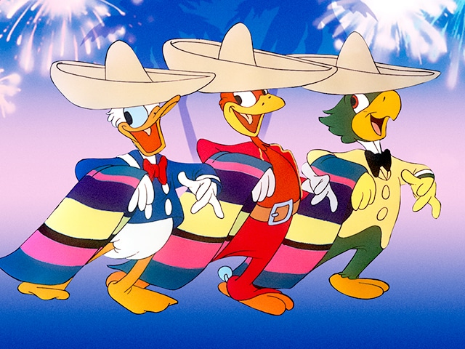
The 3 Caballeros
Ekaterina
Carlos
Tom

